Slide 1
Shanghai Green Space Utility
Ada Liu & Cecilia Cai

Slide 2
Overview
Introduction
Data Acquisition
Network Design
Experiments & Outputs
Comparison and Analysis
Conclusion & Future Work

Slide 3
Introduction
Shanghai Government has put increasing efforts in constructing green spaces in the city. However, how effective are these spaces used? What are some of the most popular activities to do in parks among the public? Who visits parks most often?
Intrigued by these questions, we constructed several networks to investigate the relationship between people’s occupation and the most frequent activities they do in Parks.
Based on our findings, we were able to offer some insightful suggestions for future improvements of the utility of green spaces in Shanghai.

Slide 4
Data Acquisition
Our data is from a previous research on Shanghai Green space constructions and native animal protection. A survey was conducted to find out public interests in park activities, which was distributed in 11 parks in Shanghai, respectively: People’s Park, Daning Park, Gucun Park, Shanghai Waterside Forest Park, Shanghai Zoo, Changfeng Park, Shanghai Botanical Garden, Century Park, Lu Xun Park, Jing’an Sculpture Park, and Shangnan Park.
Our networks were constructed with data collected from Shangnan Park, Shanghai Botanical Garden, and Jing’an Sculpture Park. The three parks are located in different areas in Shanghai, and represent different level of popularity. While the time span and distribution method of the survey were similar, Shangnan Park has the largest data size, whereas the two other parks have relatively smaller total number of data points. By comparing the results from these three parks, we would like to understand if the distributions of the survey participants’ interests would differ distinctively across different locations.

Slide 5
Data Variables
We focused on two variables -- occupation and interest -- in our networks.
The occupation of each survey participant was collected from a single-choice question, which includes 8 options, respectively: civil servant, public institution, enterprise, privately-operated, freelancer, wait for employment, student, and other.
The interests of each survey participant was collected from a multiple choice question, and one can choose one or more from the 10 options, including: stroll, physical exercise, picnic, reading, game, photography, sit and rest, chat with friends, view, and parents-child campaign.
We cleaned our data by removing the records that did not choose any option in either of the occupation or interest questions.

Slide 6
Network Design
Name | Type | Nodes | Edges
Division of Interests | Bipartite, Undirected | Survey participants, park activities | Interests for the activities
Division of Occupations | Bipartite, Undirected | Survey participants, occupations | Taken of occupation
People Sharing Interests (>=2) | Undirected | Survey participants | Individuals sharing at least 2 interests
People Sharing Interests (weighted) | Weighted, Undirected | Survey participants | Individuals sharing at least 1 interest, width weighted by the total number of shared interests

Slide 7
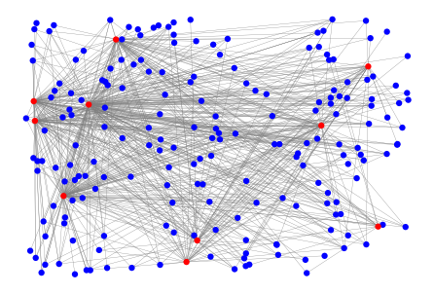
Shangnan Park (Pudong New Area) - Interest
We have nodes labeled in red and blue. Red nodes represent different interests people have when they go to green space. Blue nodes are interviewees in this park. There is a link between the red node and blue node if the interviewee has selected this as a primary interest he or she has.
Base on our design, this graph is actually bipartite, since there is no link within the red or blue group.

Slide 8
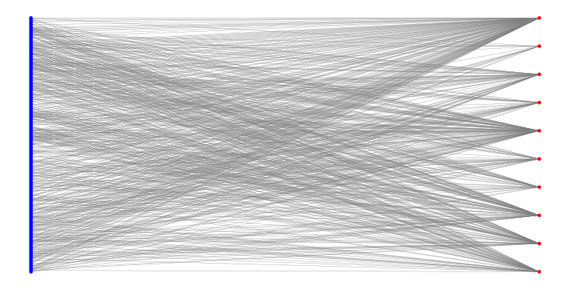
Shangnan Park (Pudong New Area)
Then, we want to improve the appearance of this graph by putting it into the actual bipartite layout, which is shown on the right.
It is much more clearer since ten options of interest are separated to the right column. And we can observe that among the red nodes, the first node has a distinguished degree meaning that the first option: strolling is a popular option.

Slide 9
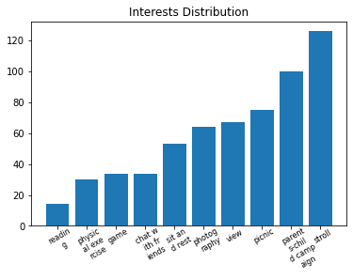
Shangnan Park - Interest Distribution
To see much more precisely the rank of prevalent activities, we draw the degree distribution of the previous graph in terms of red nodes.
The output agrees with our initial guess that the largest number of interviewees prefer strolling. And we also find that the parent-child campaign is appreciated as well. We would compare the result in Shangnan Park with other parks in this presentation as well.

Slide 10
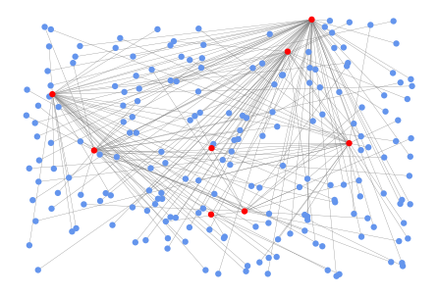
Shangnan Park - Occupation
Red nodes represent different occupations of interviewees. Blue nodes are interviewees in this park. There is a link between the red node and blue node if the interviewee is doing this job. Through this graph and its distribution, we want to explore the most popular occupation among people who come to this park. There is one red node (on the top right corner) with a distinguished degree, and we will explore which occupation it is in the next slide.

Slide 11
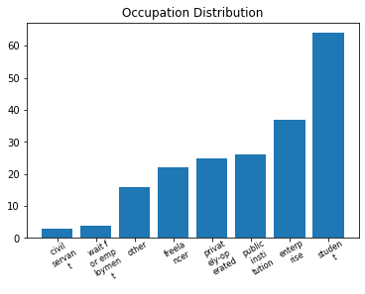
Shangnan Park - Occupation Distribution
Now we discover that the most popular group of people in Shangnan park might be students. The number of students who took our survey is about twice of people with other occupations.

Slide 12
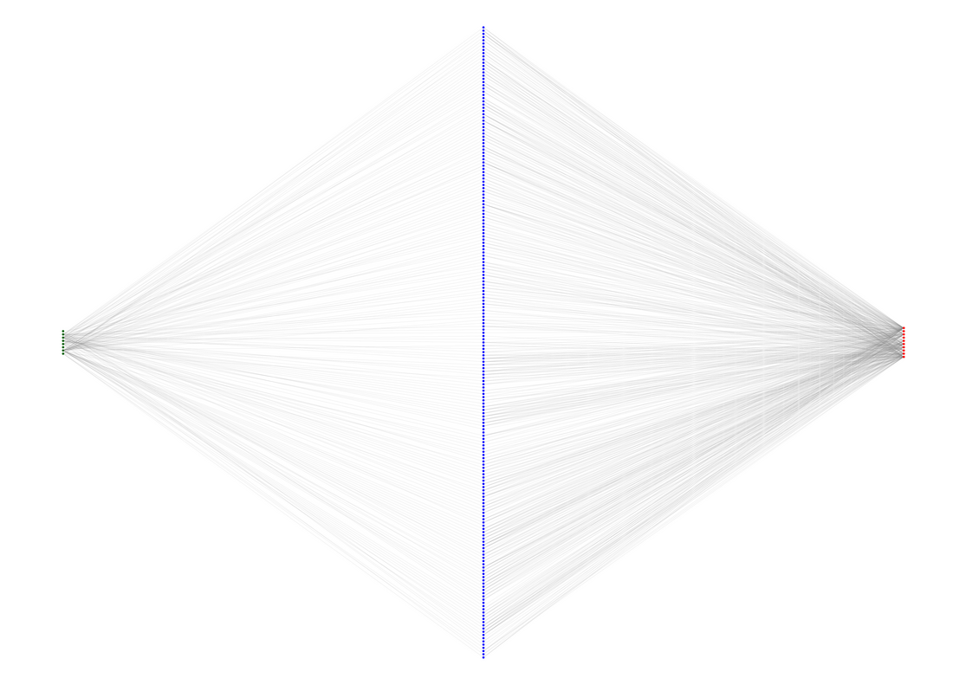
Shangnan Park - Tripartite Graph
To show all the data and information in one graph, we tried to build a tripartite graph: nodes in the left column are occupations, nodes in the middle are interviewees, and we have ten options of different interests in the right column. The way we build links is similar to what we described before.

Slide 13
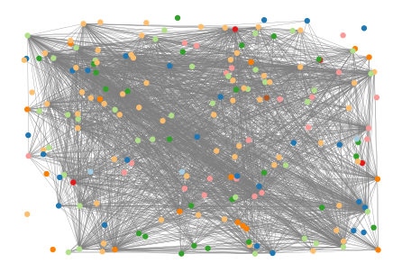
Shangnan Park - How is occupations related with interest?
In this graph, we use various colors of nodes to represent individuals with different occupations. An edge is built if two interviewees shared more than two interests, and we would like to explore to what extent this network is connected. We surprisingly find that even if most of our interviewees selected a limited number of options, the repetitive rate is relatively high. This network has a largely connected subgraph.

Slide 14
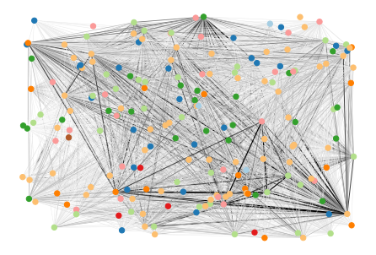
Shangnan Park - How is occupations related with interest?
Since we cannot discover how similar two nodes are from the previous graph, we develop this weighted graph: if there is only one shared interest, two nodes are linked but with a lighter edge. As the number of the same interest grows, the link between two nodes becomes darker. We observed that the highlighted node is of great significance to this network.

Slide 15








Shangnan Park - How is occupations related with interest?
To know the specific occupation, we check the node color diagram.
civil servant
freelancer
public institution
wait for employment
enterprise
student
privately-operated
other

Slide 16
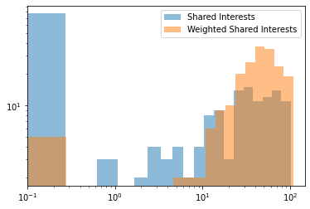
Shangnan Park - How is occupations related with interest?
Degree Distribution
From this distribution, we see that in the weighted graph, the node tend to have a very high degree if their degree is different from zero. While we can also see the disadvantages of the previous Shared Interests graph: we neglected many individuals choosing only one option or individuals who are less similar to others.

Slide 17
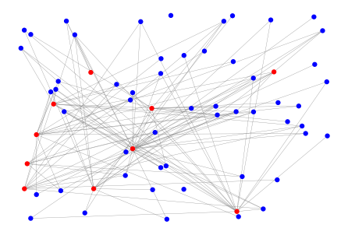
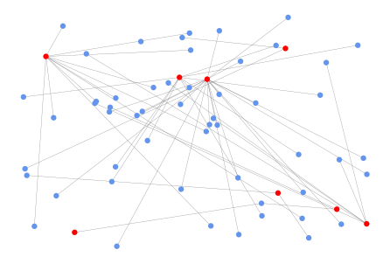
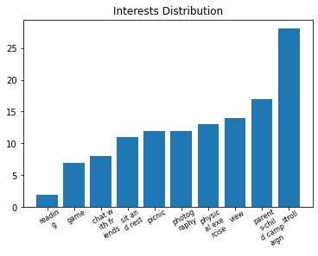
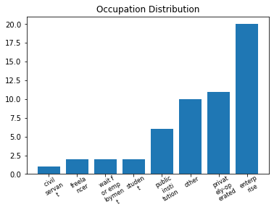
Botanical Garden - Interest & Occupation

Slide 18
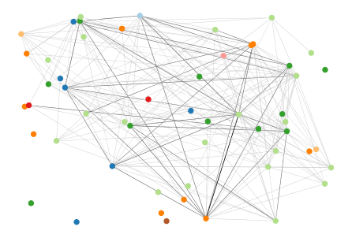
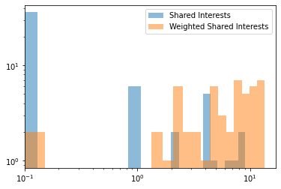
Botanical Garden - Interest & Occupation

Slide 19
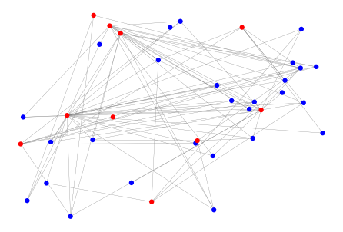
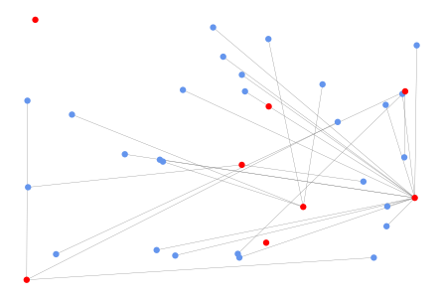
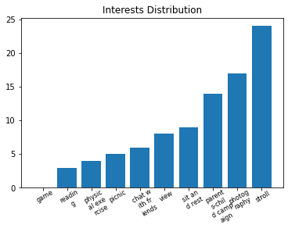
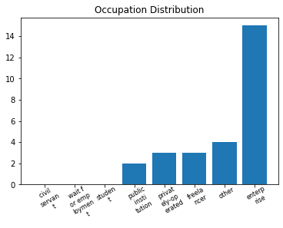
Sculpture Park - Interest & Occupation

Slide 20
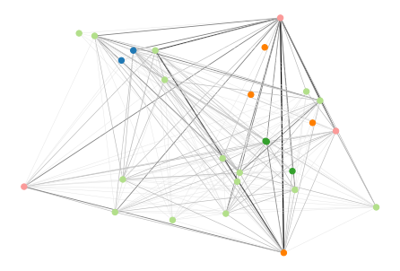
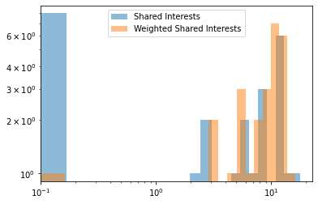
Sculpture Park - Interest & Occupation

Slide 21
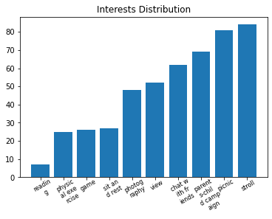
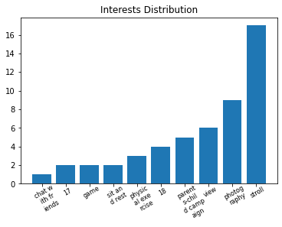
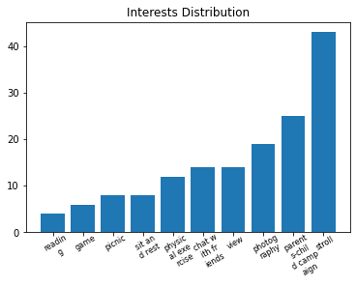
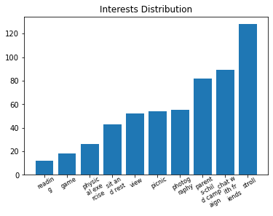
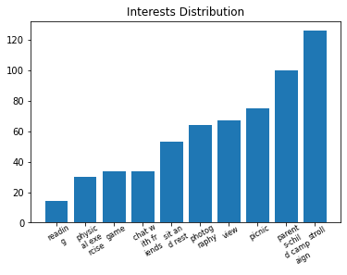
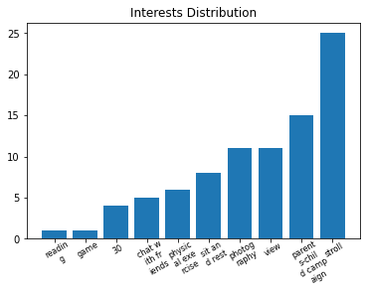
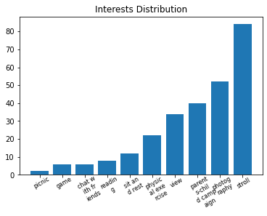
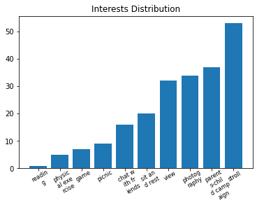
Comparison and Analysis
Bingjiang Park
Century Park
Changfeng Park
Daning Park
Gucun Park
Luxun Park
Renmin Park
Shanghai Zoo

Slide 22
Conclusion & Future Work
Conclusion
Among different parks, the primary occupations of visitors are different. But public enterprises consistently rank high. This might be related to the job specification and areas where those public enterprises locate.
People in the same parks tend to have similar favorite activities. The repetitive rate is higher than we thought, which will help us eliminate some of the outdated facilities and activities.
We find that the most popular activity among 11 parks is strolling regardless of the themes of the parks and their locations. While we also observe that activities like picnics, photography, and parent-child campaign are also widely appreciated.
The significant nodes in the occupation-interests relation graph tell us that the occupation of individuals who appreciate the most versatile and popular activities vary a lot from park to park.

Slide 23
Conclusion & Future Work
Future Work
Knowing the specific division of occupation in different parks, we will be able to draft some advice that strengthens the green space facilities in terms of the majority of visitors' favorite activities.
For the green space with low passenger flow volume, we can develop more diverse construction to attract people from all walks of life, thus improving the general green space utility.
Although the same amount of time was spent in each park during data collection, we still need to spend more time in each park in the future so as to collect more sufficient data and make further interpretations from the network.
Currently, the nodes and links in our networks are highly congregated due to large amount of data, which makes it difficult for one to attain useful insights directly from the visual. We look forward to improving the network design to display the information more efficiently.

Slide 24
Thanks for Listening!
Note that this project is a result of effort from both of us in the process of raising questions, building the networks, performing computations, plotting graphs, and making the presentation.

